Slide 1
Predicting plasticity outcomes based on LFP magnitude
Sebastiano Bariselli &
Bridget Matikainen-Ankney
BIOF309, Spring 2018

Slide 2
Background
Neural plasticity
The ability of connections between neurons to change
Test in mice
Baseline period of connectivity
Plasticity induction protocol
Post-induction connectivity

Slide 3
Question
Can we predict plasticity outcomes based on local field potential magnitude during baseline period?

Slide 4
Project goals
Import data from excel (LFP magnitudes and plasticity outcomes).
Use supervised machine learning to build model.

Slide 5
Code
import numpy as np
import pandas as pd
import matplotlib.pyplot as plt
LFP_data = pd.read_csv('C:\\Users\\BAMA\\Desktop\\Excel_Practice3d.csv')
for PRE, POST in LFP_data.iterrows():
LFP_data['CHANGE'] = LFP_data['POST']/LFP_data['PRE']
Pre = LFP_data['PRE']
Change = LFP_data['CHANGE']
Pre2 = Pre[:, np.newaxis]
#splitting our data set into 25% and 75%
from sklearn.model_selection import train_test_split
Pre2_train, Pre2_test, Change_train, Change_test = train_test_split(Pre2, Change, test_size=0.25, random_state=42)
#make a regression
from sklearn.linear_model import LinearRegression
regressor = LinearRegression()
regressor.fit(Pre2_train, Change_train)
#print regression
print('coefficients: ', regressor.coef_)
print('y-axis intercept: ', regressor.intercept_)
print('Regression: % Change =', regressor.coef_,'*Pre-stim response amplitude +', regressor.intercept_)
#plotting regression to fit training data
min_pt = Pre2.min() * regressor.coef_[0] + regressor.intercept_
max_pt = Pre2.max() * regressor.coef_[0] + regressor.intercept_
plt.plot([Pre2.min(), Pre2.max()], [min_pt, max_pt], label="regression")
plt.plot(Pre2_train, Change_train, 'o', label="train data");
#predicting target data
Change_pred_train = regressor.predict(Pre2_train)
#plt.plot(Pre2_train, Change_pred_train, 'o', label="train prediction")
#try test set
Change_pred_test = regressor.predict(Pre2_test)
plt.plot(Pre2_test, Change_test, 'o', label="test data")
#plt.plot(Pre2_test, Change_pred_test, 'o', label="test prediction")
#evaluate preditction quantitatively
R2 = regressor.score(Pre2_test, Change_test)
plt.title("Relationship between LFP amplitude and plasticity")
plt.xlabel("Pre-stim LFP amplitude")
plt.ylabel("Percent change")
plt.legend(loc='best');
plt.show()
print("R squared =", R2)

Slide 6
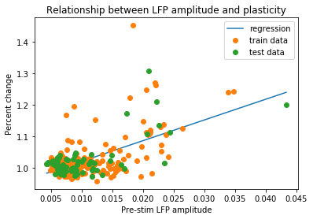
Results
Regression: % Change = [ 6.55694474] *Pre-stim response amplitude + 0.954975708918
R squared = 0.471091816409

